Slide 1
Week 4 Lecture
Algorithms and Data Structures
      Dr Mehmet Bülent Özcan,
      (Module Leader/Lecturer/Tutor)
        Room: Cantor 9418
        Phone: extn 6900
        Email: m.b.ozcan@shu.ac.uk

Slide 2
Learning Objectives
To understand the stack data structure and some of its applications

Slide 3
Contents of the Lecture
Stacks
Representation of Stack as an Abstract Data Type (Class)
States
Representation of Stacks in Memory
Array Representation
Singly Linked List Representation
Algorithms based on Array Representation

Slide 4
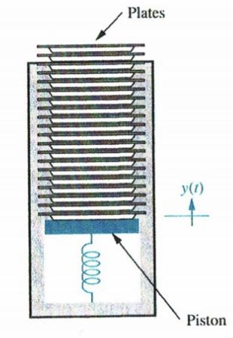
Stacks
A stack, also called a last-in first-out (LIFO) system, is a linear list in which insertions and deletions can take place only at one end, called the top. This structure is similar in its operation to a stack of dishes on a spring system, as shown below. Note that new dishes are inserted only at the top of the stack and dishes can be deleted only from the top of the stack.

Slide 5
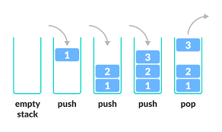
Stacks (2)

Slide 6
Representation of Stack as an Abstract Data Type (Class)
If we regard a stack as an object, we can represent it using the UML (Unified Modelling Language) notation as shown below:

Slide 7
Representation of Stack as an Abstract Data Type (Class) (2)
Attributes represent data, which stacks are associated with or handle.
Operations represent functions that are applicable to stacks to handle data. They collectively represent a stack’s behaviour.
States, which are not included in the UML notation, constrain the operations applicable to a stack.

Slide 8
States
Empty: A stack can be empty under two circumstances:
  when it is created
  when all items stored in it are deleted
Empty constrains two operations. Thus, this state must be checked before applying them. They are:
  top()/peek(): it is not possible to retrieve an item when a stack is empty.
  pop(): it is not possible to remove an item from an empty stack.
Full: A stack can be full under the following circumstance.
  When its capacity is exhausted.
Full constrains one operation. Thus, this state must be checked before applying it. It is:
  push(): it is not possible to insert an item when a stack is full.

Slide 9
Representation of Stacks in Memory
Stacks may be represented in the computer various ways, usually by means of a singly linked list or a linear array.
We will outline both representations but focus only on the array representation in this lecture.
declare STACK[1..max], top, item

Slide 10
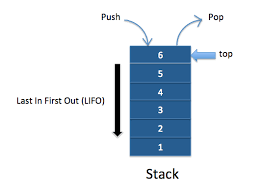
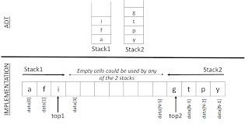
Array Representation

Slide 11
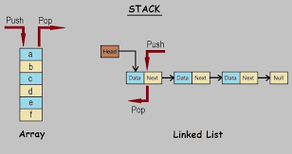
Singly Linked List Representation

Slide 12
ADL Syntax for Abstract Data Types (Class)
CLASS <name>
STATES
{state} // a set of states
REPRESENTATION
// Memory representation, e.g., array
OPERATIONS
{operation} // a set of operations
ALGORITHMS
// a set of precondition and algorithm for each operation
{<precondition> <algorithm>}
END

Slide 13
Array Representation- Algorithms
CLASS Stack
STATES
full, empty /* full means a full stack, etc. */
REPRESENTATION
declare STACK[0..max-1], top, item
OPERATIONS
procedure create()
procedure push(IN item)
procedure pop(OUT item)
function peek()
function isEmpty()
function isFull()

Slide 14
Array Representation- Algorithms (2)
AlGORITHMS
Precondition: true (i.e., there is no precondition).
procedure create()
top ← -1
end

Slide 15
Array Representation- Algorithms (3)
Precondition:
if isFull(IN top, IN max) = true then CALL stackFULL()
endif
procedure push(IN item)
top ← top + 1
STACK(top) ← item
end

Slide 16
Array Representation- Algorithms (4)
Precondition:
if isEmpty(top) = true then CALL stackEMPTY()
endif
procedure pop(OUT item)
item ← STACK(top)
top ← top - 1
end

Slide 17
Array Representation- Algorithms (5)
Precondition:
if isEmpty(top) = true then CALL stackEMPTY()
endif
function peek()
return STACK(top)
end

Slide 18
Array Representation- Algorithms (6)
Precondition: true Precondition: true
function isEmpty() function isFull()
if top = -1 then return true if (top = max – 1) then
return true
else return false else return false
endif endif
end end
END

